Slide 1

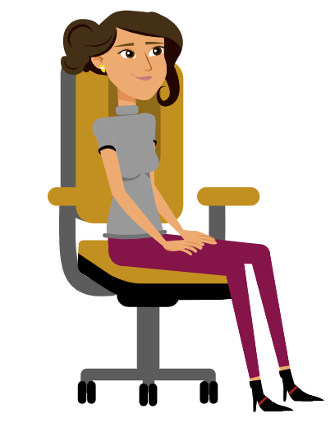
Wearable-based Activity Log Generation
(WALG)
Mohit Garg (705430435)
Rahul Garg (705429125)
Instructor: Prof. Mani Srivastava
Course: ECE M202A (Embedded Systems)
Walking
Sitting

Slide 2
Motivation for Human Activity Recognition
Human activity recognition refers to predict what a person is doing from series of the observation of person’s action.
Active research area.
Provides personalized support for various applications.
Associated with a wide range of fields of study like medicinal services, dependable automation developing, and smart surveillance system.

Slide 3
Overall Project Goals and Specific Aims
With the ubiquitous presence of smart wearable devices around us, a huge amount of sensor data is generated on a daily basis.
In this project, we are aiming to use the sensor data retrieved from wearable devices to recognize and log the human activities.
We are using the IMU data (accelerometer, gyroscope) obtained from an Apple Watch worn by the user on their dominant hand.
The targeted human activities are sitting, walking, eating and brushing teeth.

Slide 4
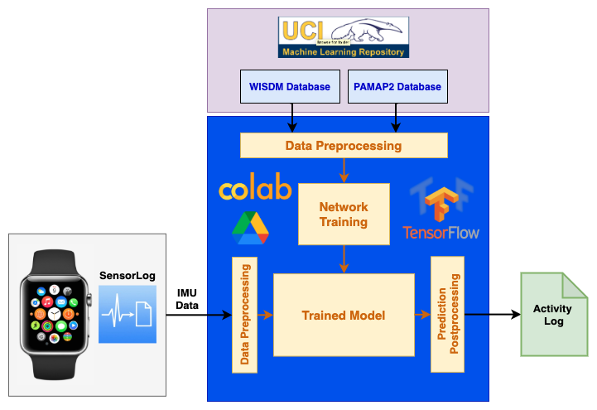
Technical Approach
Datasets
For training, we are using two different datasets - WISDM and PAMAP2. We are applying preprocessing to generate data windows that are fed to the model.
Platform
We are using Google Colaboratory for developing the models with tensorflow and Google Drive for storage.
Algorithms
We are using Convolutional Neural Networks (CNNs) to detect the human activity.
Data Collection The SensorLog app on Apple Watch is used to collect 6-DOF IMU data (accelerometer and gyroscope).

Slide 5
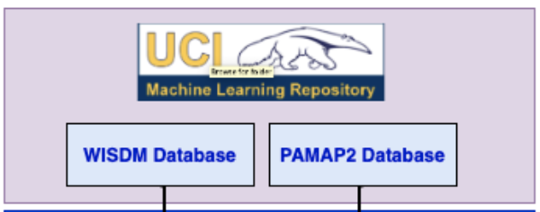
Dataset Selection
PAMAP2 dataset is too small to train a large model successfully.
WISDM dataset has data for 51 users which is enough to train our target models.
After training, the model is used to predict activities from data collected in real-time.
To prevent the trained model from getting biased towards any particular dataset, we are using a combination of WISDM and PAMAP2 datasets.
Links to the datasets: WISDM and PAMAP2

Slide 6
Training Data Preprocessing
Raw PAMAP2 dataset
(.dat files)
Raw WISDM dataset
(.csv files)
Preprocess_PAMAP2.ipynb
Select hand accel and gyro data
Reduce sampling frequency
Generate sliding windows
Add mean and standard deviation
Preprocess_WISDM_PAMAP2.ipynb
Select wrist accel and gyro data
Generate sliding windows for WISDM
Add mean and standard deviation to WISDM
Merge processed PAMAP2 and WISDM datasets
Processed PAMAP2 dataset
(.npy files)
Processed PAMAP2 + WISDM dataset (.npy files)

Slide 7
Training Data Preprocessing
Sampling Frequency:
  WISDM and PAMAP2 use sampling frequencies of 20 Hz and 100 Hz respectively.
  PAMAP2 dataset has been downsampled to match WISDM’s frequency.
Sliding Window:
  We are using the sliding window approach to split data into fixed size windows.
  With experimentation, we found that a sliding window of 10 seconds (200 samples) and a stride of 2 seconds (40 samples) works best.
Mean and Standard Deviation:
  To recover the accuracy loss because of a limited number of input features (sensors), we added additional features like mean and standard deviation to the sampled windows.
Links to the processed data: PAMAP2, WISDM+PAMAP2

Slide 8
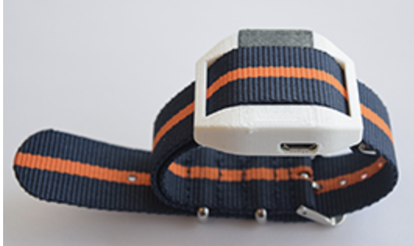
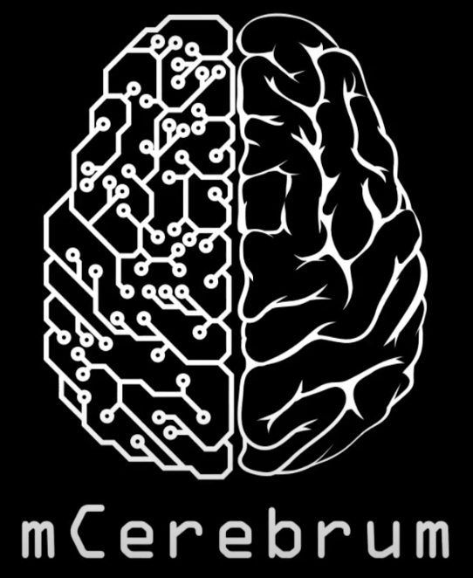
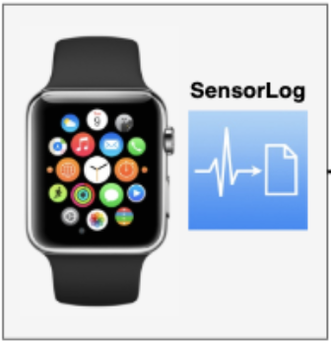
Real-time Data Collection
We started the real-time data collection using the MotionSenseHRV wearable along with the mCerebrum app.
Because of multiple issues with the wearable/app, we switched over to using Apple Watch.
We are using the SensorLog app to collect IMU data (accelerometer, gyroscope) from Apple Watch.
This app provides us raw IMU data in CSV format with timestamps.
Link to raw csv files.

Slide 9
Real-time Data Preprocessing
Sampling Frequency:
  SensorLog app allows us to directly sample the data at 20 Hz.
Sliding Window:
  We are using the sliding window approach to split data into fixed size windows of 10 seconds (200 samples) and a stride of 2 seconds (40 samples).
Mean and Standard Deviation:
  We are adding additional features like mean and standard deviation to the sampled windows.
Link to the processed real-time data.
Raw real-time data
(.csv files)
Preprocess_Live_Data.ipynb
Select timestamps, accel and gyro data
Generate sliding windows
Add mean and standard deviation
Processed real-time data
(.npy files)

Slide 10
Model Topology
After experimenting with multiple different neural network topologies like MLPs, CNNs, LSTMs and ConvLSTMs, we found that CNN works the best for us.
To improve the model’s accuracy, we tried many different network configurations and the following network topology gives us the best results:
  Conv2D (6, 202, 64), BatchNormalization, MaxPooling2D, Dropout
  Conv2D (6, 101, 64), BatchNormalization, MaxPooling2D, Dropout
  Conv2D (6, 50, 64), BatchNormalization, MaxPooling2D, Dropout
  Flatten (9600)
  Dense (32), BatchNormalization, Dropout
  Dense (7)

Slide 11
Model Training
The processed training dataset has been randomly divided into following subsets:
We are training the model for 70 epochs with a batch size of 256.
It takes around 4 minutes and 40 seconds to train and validate our model.
After training, the best model is saved which is later on loaded for inference with the test data and real-time data.
WISDM+PAMAP2 | Training | Validation | Test
Number of subjects | (35+7) | (8+1) | (8+1)

Slide 12
Inference with Real-time Data
Inference for Model Development
  To verify the accuracy of our model on real-time data, we collected multiple data files for each target activity with two different subjects.
  These data files were used to make decisions in the model development process.
Inference for Demo
  For final demo, we are using a different subject than the ones which were used during model development.
  Our subject performed all 4 target activities consecutively.

Slide 13
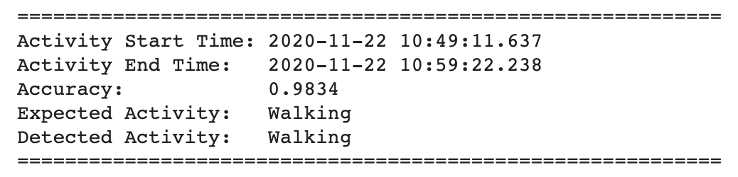
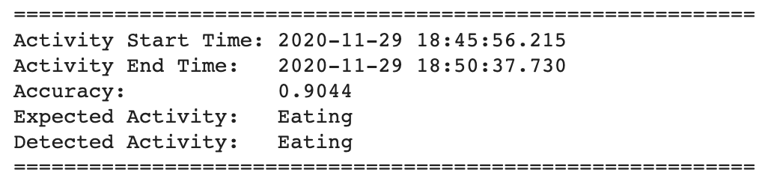
Results from Real-Time Inference

Slide 14
Techniques used to Improve Accuracy
Network Tuning: We tried changing number of layers, number of features per layer, adding different types of layers like BatchNormalization, Dropout etc.
Merge Activities: We are merging data for multiple similar activities under single label. For example, Sitting = Sitting + Typing.
Additional Activities: We observed that adding some extra activities (which are not targeted) help to improve the prediction accuracy for the targeted activities.
Window Size: We are using an intermediate value of 10 seconds for window size.

Slide 15
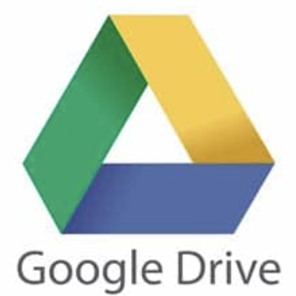


Platforms Used
Google Drive
  All our data was stored on Google Drive
  Shared Drives feature helped us in easier collaboration
Google Colaboratory
  All python scripting was done on Google Colab
  Linking Drive with Colab allowed easy access to the data
TensorFlow
  All the model development and training was done using TF

Slide 16
Conclusion
Applications of Human Activity Recognition (HAR) in wide range of domains makes it an important research area.
The recent advancements in machine learning can be applied to HAR too.
In this project, we have shown one such successful and more practical approach in applying deep learning to detect 4 different day-to-day activities (Walking, Sitting, Eating, Brushing Teeth).
This work can be extended to include more activities by adding more sensors (such as heart-rate monitor) and by using new advancements in machine learning.

Slide 17
Thank You!

